Slide 1

Introduction to Probabilistic Machine Learning
Ralf Herbrich
Information Theory

Slide 2
Overview
Basics of Information Theory
Probability and Compression: Arithmetic Coding
Distance Measures for Probabilities Revisited

Slide 3
Overview
Basics of Information Theory
Probability and Compression: Arithmetic Coding
Distance Measures for Probabilities Revisited

Slide 4

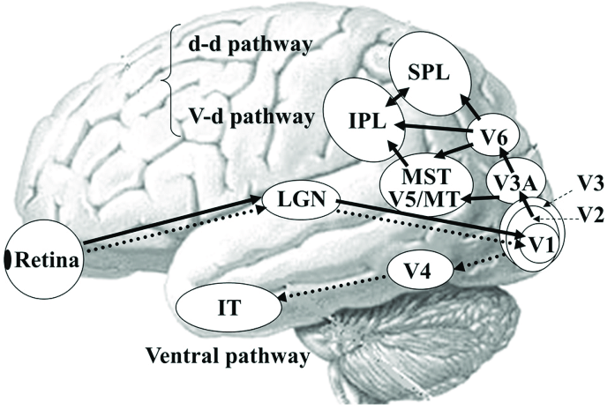
What is Information?
Information: Facts, data or knowledge communicated or received about a particular situation, person, event or topic
Provides understanding or allows for informed decisions
Encoding and decoding information for transmission and interpretation is key!
Example: Visual processing
Information Theory: Mathematical study of the quantification, storage, and communication of information.
Information: A set of messages where the goal is to send the messages over a noisy channel, and to have the receiver reconstruct the message with low error probability
Less than 100 years old and established by Claude Shannon in 1948
~~4-6 billon cells in human visual cortex
~96 million photoreceptor cells
Claude Shannon (1913 – 2001)
~140 million V1 cells
~1.5 million retinal ganglion cells

Slide 5



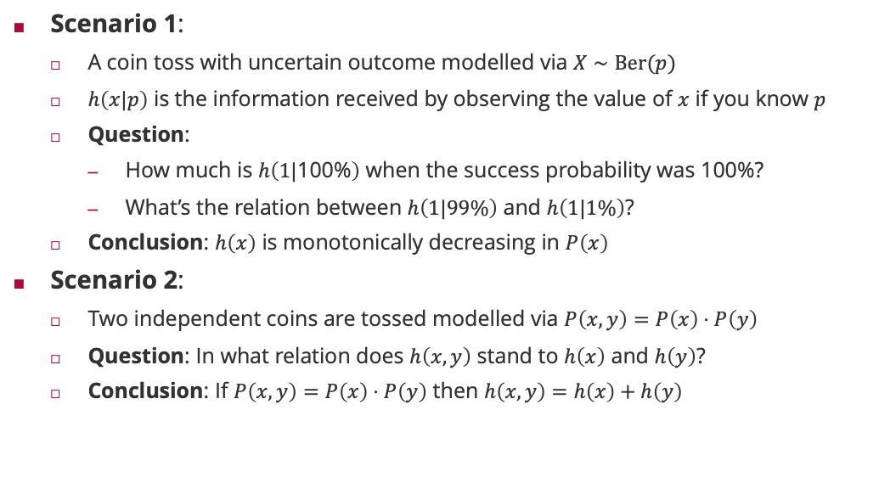






Motivating Example: Information and Coin Tosses
$$h\left(x,y\right) =h\left(x\right)+h\left(y\right)$$
$$h\left(x,y\right) >h\left(x\right)+h\left(y\right)$$
Scenario 1:
A coin toss with uncertain outcome modelled via $X∼Ber(p)$
$h\left(x|p\right)$ is the information received by observing the value of $x$ if you know $p$
Question:
How much is $h\left(1|\text{100\%}\right)$ when the success probability was 100%?
What’s the relation between $h\left(1|99\%\right)$ and $h\left(1|1\%\right)$?
Conclusion: $h\left(x\right)$ is monotonically decreasing in $P\left(x\right)$
Scenario 2:
Two independent coins are tossed modelled via $P\left(x,y\right)=P\left(x\right)⋅P\left(y\right)$
Question: In what relation does $h\left(x,y\right)$ stand to $h\left(x\right)$ and $h\left(y\right)$?
Conclusion: If $P\left(x,y\right)=P\left(x\right)⋅P\left(y\right)$ then $h\left(x,y\right)=h\left(x\right)+h\left(y\right)$
$$h\left(1|99\%\right)>h\left(1|1\%\right)$$
$$h(1|100\%) = 0$$
$$h\left(1|99\%\right)<h\left(1|1\%\right)$$
$$h\left(1|100\%\right)> 0$$
$$h\left(x,y\right) <h\left(x\right)+h\left(y\right)$$
$$h\left(1|99\%\right)=h\left(1|1\%\right)$$
$$h\left(x\right)=−\log_{b}\left(P\left(x\right)\right)⁡$$

Slide 6









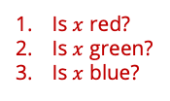





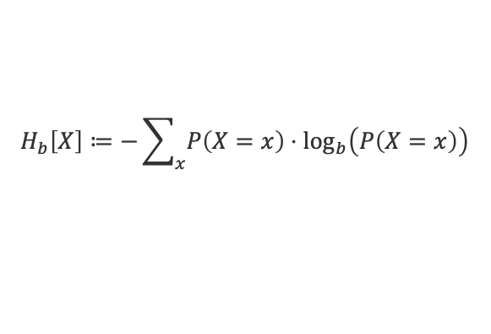



Measure of Information: Entropy
Observation: Information $h(x)$ is only defined for a particular outcome $x$!
Entropy. The entropy of a random variable $X$ is the average level of information inherent to the variable’s outcomes and is defined by ($b>1$)
Interpretations of Entropy:
Minimum number of random bits to draw outcomes from $X∼P$ on average
Average number of bits to store a compressed outcome of $X∼P$
Minimum number of yes/no questions on average to guess a draw from $X∼P$
Example
$$X$$ | $$red$$ | $$green$$ | $$blue$$ | $$yellow$$
$$P\left(X=x\right)$$ | $$\frac{1}{2}$$ | $$\frac{1}{4}$$ | $$\frac{1}{8}$$ | $$\frac{1}{8}$$
$$H_{b}\left[X\right]≔−\sum_{x}{P\left(X=x\right)⋅\log_{b}\left(P\left(X=x\right)\right)}$$
$$=E_{X∼P}\left[−\log_{b}\left(P\left(X\right)\right)\right]$$
$$H_{2}\left[X\right]=\frac{1}{2}+\frac{1}{4}⋅2+\frac{1}{8}⋅3+\frac{1}{8}⋅3=1.75$$
$$−h(x)$$
$$b_{1}$$
$$red$$
$$b_{2}$$
$$P\left(X=red\right)⋅1+P\left(X=green\right)⋅2+P\left(X=blue\right)⋅3+P\left(X=yellow\right)⋅3$$
$$=H_{2}\left[X\right]$$
$$green$$
$$b_{3}$$
$$blue$$
$$yellow$$
$$average number of bits=\sum_{x∈\left\{red,blue,green,yellow\right\}}{P\left(X=x\right)⋅\left|C\left(x\right)\right|}$$
$$X$$ | $$C\left(X\right)$$
$$red$$ | $$0_{2}$$
$$green$$ | $${10}_{2}$$
$$blue$$ | $${110}_{2}$$
$$yellow$$ | $${111}_{2}$$
$$=H_{2}\left[X\right]$$
Is $x$ red?
Is $x$ green?
Is $x$ blue?
$$P\left(X=red\right)⋅1+P\left(X=green\right)⋅2+P\left(X=blue\right)⋅3+P\left(X=yellow\right)⋅3$$
$$=H_{2}\left[X\right]$$

Slide 7
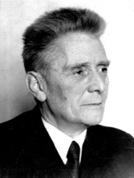
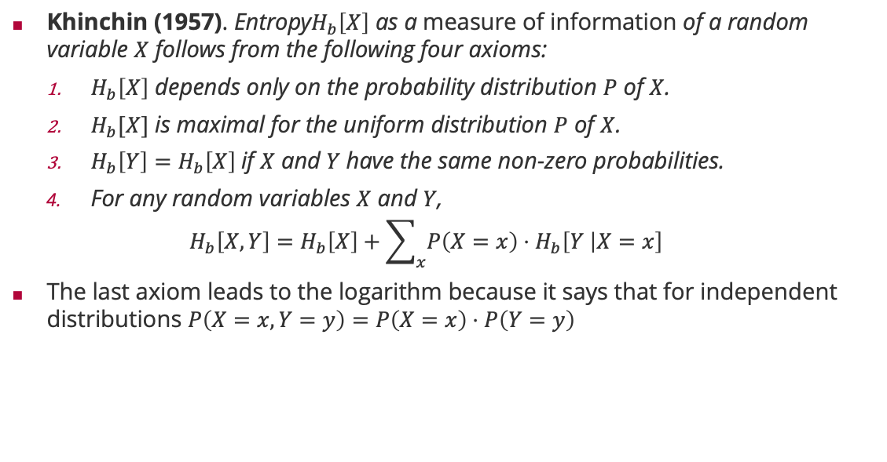



Entropy: An Axiomatic Introduction
Khinchin (1957). Entropy$H_{b}\left[X\right]$ as a measure of information of a random variable $X$ follows from the following four axioms:
$H_{b}\left[X\right]$ depends only on the probability distribution $P$ of $X$.
$H_{b}[X]$ is maximal for the uniform distribution $P$ of $X$.
$H_{b}\left[Y\right]=H_{b}\left[X\right]$if $X$ and $Y$have the same non-zero probabilities.
For any random variables $X$ and $Y$,
$$H_{b}\left[X, Y\right]=H_{b}\left[X\right]+\sum_{x}{P\left(X=x\right)⋅H_{b}\left[Y | X=x\right]}$$
The last axiom leads to the logarithm because it says that for independent distributions $P\left(X=x,Y=y\right)=P\left(X=x\right)⋅P\left(Y=y\right)$
Aleksandr Khinchin (1894 – 1959)
$$H_{b}\left[Y|X\right]$$
$$H_{b}\left[Y|X\right]=H_{b}\left[Y\right]$$
$$⇔H_{b}\left[X,Y\right]=H_{b}\left[X\right]+H_{b}\left[Y\right]$$

Slide 8
Example: Binary Entropy
$$H_{2}\left[Ber\left(⋅;p\right)\right]=−\left(p⋅\log_{2}\left(p\right)+\left(1−p\right)⋅\log_{2}\left(1−p\right)\right)$$

Slide 9
Overview
Basics of Information Theory
Probability and Compression: Arithmetic Coding
Distance Measures for Probabilities Revisited

Slide 10

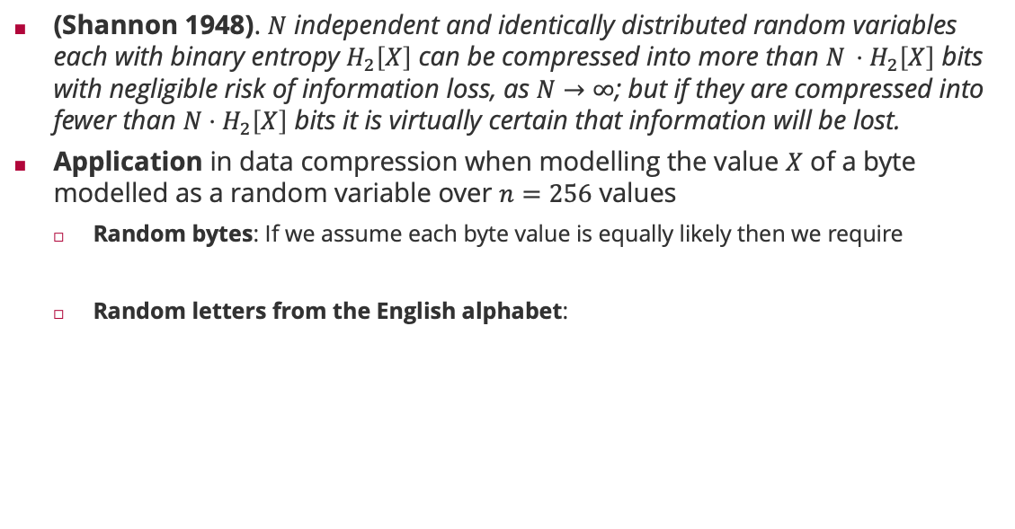

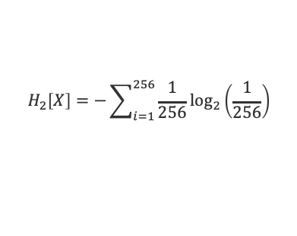

Entropy and the Noiseless Coding Theorem
(Shannon 1948). $N$ independent and identically distributed random variables each with binary entropy $H_{2}\left[X\right]$ can be compressed into more than $N ⋅H_{2}\left[X\right]$ bits with negligible risk of information loss, as $N→∞$; but if they are compressed into fewer than $N⋅H_{2}\left[X\right]$ bits it is virtually certain that information will be lost.
Application in data compression when modelling the value $X$ of a byte modelled as a random variable over $n=256$ values
Random bytes: If we assume each byte value is equally likely then we require
Random letters from the English alphabet:
$$H_{2}\left[X\right]=−\sum_{i=1}^{256}{\frac{1}{256}\log_{2}\left(\frac{1}{256}\right)}$$
$$=−\log_{2}\left(\frac{1}{256}\right)$$
Claude Shannon (1913 – 2001)
$$=8 bits$$
$$H_{2}\left[X\right]≈ 4.49 bits$$

Slide 11
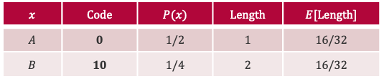


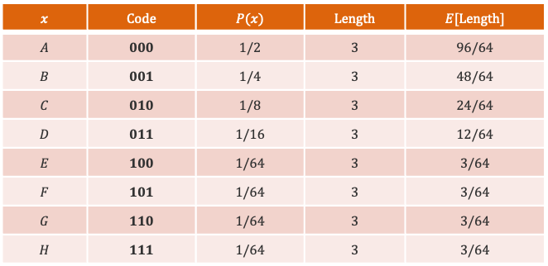





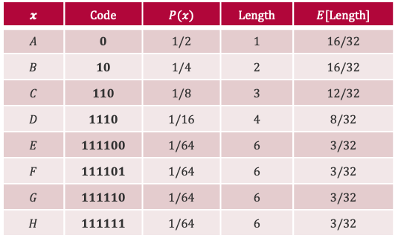


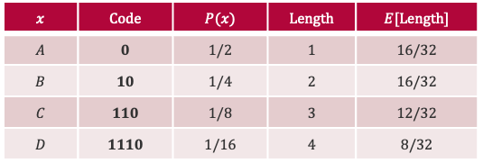


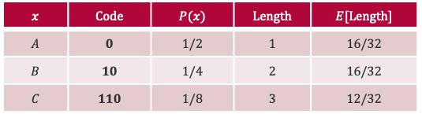

Noiseless Coding Theorem: Example
Scenario: $X∈\left\{A,B,C,D,E,F,G,H\right\}$ with probabilities $\left\{\frac{1}{2},\frac{1}{4},\frac{1}{8},\frac{1}{16},\frac{1}{64},\frac{1}{64},\frac{1}{64},\frac{1}{64}\right\}$
$$H_{2}\left[X\right]=\frac{1}{2}⋅1+\frac{1}{4}⋅2+\frac{1}{8}⋅3 +\frac{1}{16}⋅4+4⋅\frac{1}{64}⋅6=2$$
Fixed-Length Code
Prefix Code
Each binary string of length $3$
Unique binary prefix of consecutive 1’s for each unique probability
$$x$$ | $$Code$$ | $$P(x)$$ | $$Length$$ | $$E[Length]$$
$$x$$ | $$Code$$ | $$P(x)$$ | $$Length$$ | $$E[Length]$$
$$A$$ | $$0$$ | $$1/2$$ | $$1$$ | $$16/32$$
$$x$$ | $$Code$$ | $$P(x)$$ | $$Length$$ | $$E[Length]$$
$$A$$ | $$0$$ | $$1/2$$ | $$1$$ | $$16/32$$
$$B$$ | $$10$$ | $$1/4$$ | $$2$$ | $$16/32$$
$$x$$ | $$Code$$ | $$P(x)$$ | $$Length$$ | $$E[Length]$$
$$A$$ | $$0$$ | $$1/2$$ | $$1$$ | $$16/32$$
$$B$$ | $$10$$ | $$1/4$$ | $$2$$ | $$16/32$$
$$C$$ | $$110$$ | $$1/8$$ | $$3$$ | $$12/32$$
$$x$$ | $$Code$$ | $$P(x)$$ | $$Length$$ | $$E[Length]$$
$$A$$ | $$0$$ | $$1/2$$ | $$1$$ | $$16/32$$
$$B$$ | $$10$$ | $$1/4$$ | $$2$$ | $$16/32$$
$$C$$ | $$110$$ | $$1/8$$ | $$3$$ | $$12/32$$
$$D$$ | $$1110$$ | $$1/16$$ | $$4$$ | $$8/32$$
$$x$$ | $$Code$$ | $$P(x)$$ | $$Length$$ | $$E[Length]$$
$$A$$ | $$000$$ | $$1/2$$ | $$3$$ | $$96/64$$
$$B$$ | $$001$$ | $$1/4$$ | $$3$$ | $$48/64$$
$$C$$ | $$010$$ | $$1/8$$ | $$3$$ | $$24/64$$
$$D$$ | $$011$$ | $$1/16$$ | $$3$$ | $$12/64$$
$$E$$ | $$100$$ | $$1/64$$ | $$3$$ | $$3/64$$
$$F$$ | $$101$$ | $$1/64$$ | $$3$$ | $$3/64$$
$$G$$ | $$110$$ | $$1/64$$ | $$3$$ | $$3/64$$
$$H$$ | $$111$$ | $$1/64$$ | $$3$$ | $$3/64$$
$$x$$ | $$Code$$ | $$P(x)$$ | $$Length$$ | $$E[Length]$$
$$A$$ | $$0$$ | $$1/2$$ | $$1$$ | $$16/32$$
$$B$$ | $$10$$ | $$1/4$$ | $$2$$ | $$16/32$$
$$C$$ | $$110$$ | $$1/8$$ | $$3$$ | $$12/32$$
$$D$$ | $$1110$$ | $$1/16$$ | $$4$$ | $$8/32$$
$$E$$ | $$111100$$ | $$1/64$$ | $$6$$ | $$3/32$$
$$F$$ | $$111101$$ | $$1/64$$ | $$6$$ | $$3/32$$
$$G$$ | $$111110$$ | $$1/64$$ | $$6$$ | $$3/32$$
$$H$$ | $$111111$$ | $$1/64$$ | $$6$$ | $$3/32$$
Decode: 1 1 1 0 0 1 0 1 0
$$\frac{192}{64}=3 bits$$
Decode: 1 1 1 0 0 1 0 1 0
$$\frac{64}{32}=2 bits$$
$$H$$
$$B$$
$$C$$
$$D$$
$$A$$
$$B$$
$$B$$

Slide 12
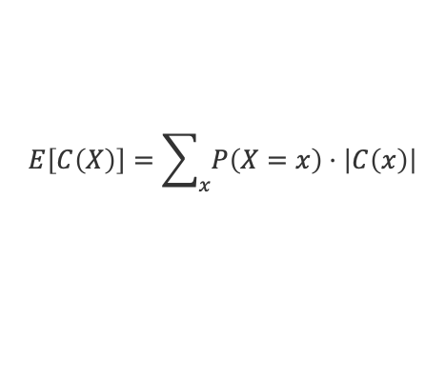
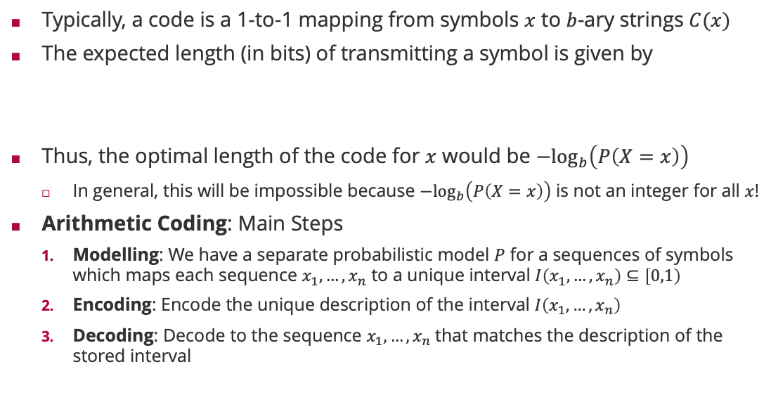
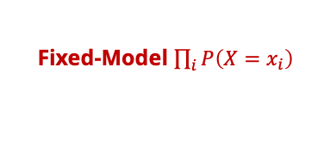

Optimal Codes: Arithmetic Coding
Typically, a code is a 1-to-1 mapping from symbols $x$ to $b$-ary strings $C(x)$
The expected length (in bits) of transmitting a symbol is given by
Thus, the optimal length of the code for $x$ would be $−\log_{b}\left(P\left(X=x\right)\right)$
In general, this will be impossible because $−\log_{b}\left(P\left(X=x\right)\right)$ is not an integer for all $x$!
Arithmetic Coding: Main Steps
Modelling: We have a separate probabilistic model $P$ for a sequences of symbols which maps each sequence $x_{1},…,x_{n}$ to a unique interval $I\left(x_{1},…,x_{n}\right)⊆\left[0,1\right)$
Encoding: Encode the unique description of the interval $I\left(x_{1},…,x_{n}\right)$
Decoding: Decode to the sequence $x_{1},…,x_{n}$that matches the description of the stored interval
$=H_{b}\left[X\right]$ if $\left|C\left(x\right)\right|=−\log_{b}\left(P\left(X=x\right)\right)$
$$E\left[C\left(X\right)\right]=\sum_{x}{P\left(X=x\right)⋅\left|C\left(x\right)\right|}$$
Fixed-Model $\prod_{i}{P\left(X=x_{i}\right)}$
The length of $I\left(x_{1},…,x_{n}\right)$ equals $P\left(x_{1},…,x_{n}\right)$!

Slide 13
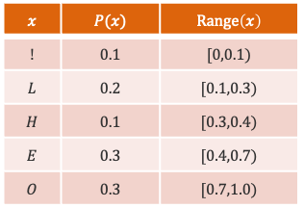



Arithmetic Coding: Fixed Probability Model
HELLO
$$x$$ | $$P(x)$$ | $$Range\left(x\right)$$
$$!$$ | $$0.1$$ | $$[0,0.1)$$
$$L$$ | $$0.2$$ | $$[0.1,0.3)$$
$$H$$ | $$0.1$$ | $$[0.3,0.4)$$
$$E$$ | $$0.3$$ | $$[0.4,0.7)$$
$$O$$ | $$0.3$$ | $$[0.7,1.0)$$
$$Range(“HELLO”) = [0.3444,0.3448)$$
$$C(“HELLO”) = 3446$$
$$\log_{10}{P(“HELLO”)}≈ 3.44$$

Slide 14
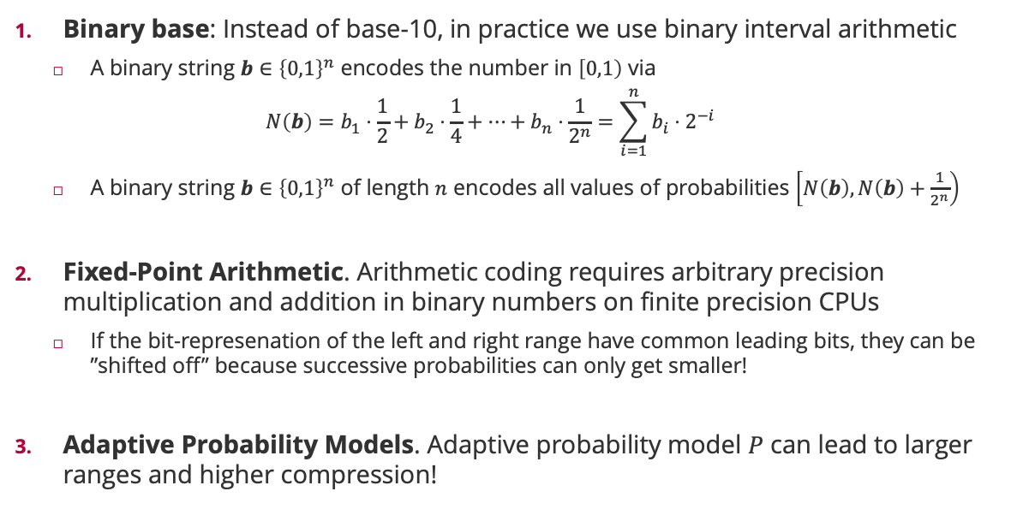
Arithmetic Coding: Practical Considerations
Binary base: Instead of base-10, in practice we use binary interval arithmetic
A binary string $b∈{\left\{0,1\right\}}^{n}$ encodes the number in $\left[0,1\right)$ via
$$N\left(b\right)=b_{1}⋅\frac{1}{2}+b_{2}⋅\frac{1}{4}+⋯+b_{n}⋅\frac{1}{2^{n}}=\sum_{i=1}^{n}{{b_{i}⋅2}^{−i}}$$
A binary string $b∈{\left\{0,1\right\}}^{n}$ of length $n$ encodes all values of probabilities $\left[N\left(b\right),N\left(b\right)+\frac{1}{2^{n}}\right)$
Fixed-Point Arithmetic. Arithmetic coding requires arbitrary precision multiplication and addition in binary numbers on finite precision CPUs
If the bit-represenation of the left and right range have common leading bits, they can be ”shifted off” because successive probabilities can only get smaller!
Adaptive Probability Models. Adaptive probability model $P$ can lead to larger ranges and higher compression!
$$P\left(x_{1},…,x_{n}\right)=P\left(x_{1}\right)⋅P\left(x_{2} | x_{1}\right)⋅⋯⋅P\left(x_{n}|x_{1},…,x_{n−1}\right)$$

Slide 15
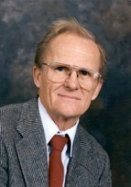
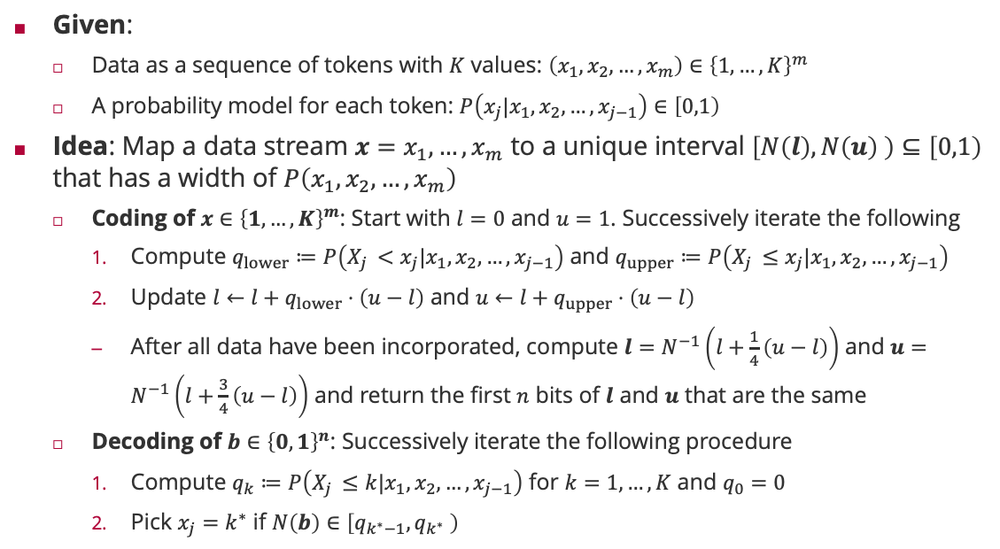
Arithmetic Coding: Algorithm
Given:
Data as a sequence of tokens with $K$ values: $\left(x_{1},x_{2},…,x_{m}\right)∈{\left\{1,…,K\right\}}^{m}$
A probability model for each token: $P\left(x_{j}|x_{1},x_{2},…,x_{j−1}\right)∈\left[0,1\right)$
Idea: Map a data stream $x=x_{1}, …,x_{m}$ to a unique interval $\left[N\left(l\right),N\left(u\right) \right)⊆\left[0,1\right)$ that has a width of $P\left(x_{1},x_{2},…,x_{m}\right)$
Coding of $x∈{\left\{1,…,K\right\}}^{m}$: Start with $l=0$ and $u=1$. Successively iterate the following
Compute $q_{lower}≔P\left(X_{j }<x_{j}|x_{1},x_{2},…,x_{j−1}\right)$ and $q_{upper}≔P\left(X_{j }≤x_{j}|x_{1},x_{2},…,x_{j−1}\right)$
Update $l←l+q_{lower}⋅\left(u−l\right)$ and $u←l+q_{upper}⋅\left(u−l\right)$
After all data have been incorporated, compute $l=N^{−1}\left(l+\frac{1}{4}\left(u−l\right)\right)$ and $u=N^{−1}\left(l+\frac{3}{4}\left(u−l\right)\right)$ and return the first $n$ bits of $l$ and $u$ that are the same
Decoding of $b∈{\left\{0,1\right\}}^{n}$: Successively iterate the following procedure
Compute $q_{k}≔P\left(X_{j }≤k|x_{1},x_{2},…,x_{j−1}\right)$ for $k=1,…,K$ and $q_{0}=0$
Pick $x_{j}=k^{∗}$ if $N\left(b\right)∈\left[q_{k^{∗}−1},q_{k^{∗}} \right)$
Jorma Rissanen (1932 – 2020)

Slide 16
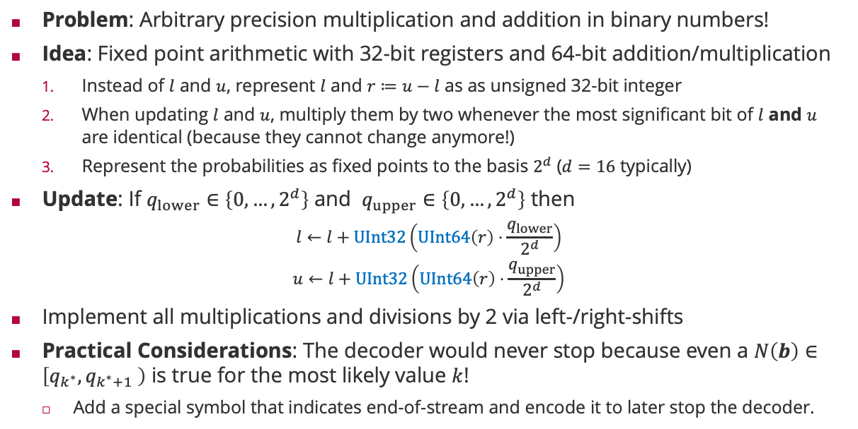
Arithmetic Coding: Fixed Point Arithmetic
Problem: Arbitrary precision multiplication and addition in binary numbers!
Idea: Fixed point arithmetic with 32-bit registers and 64-bit addition/multiplication
Instead of $l$ and $u$, represent $l$ and $r≔u−l$ as as unsigned 32-bit integer
When updating $l$ and $u$, multiply them by two whenever the most significant bit of $l$ and $u$ are identical (because they cannot change anymore!)
Represent the probabilities as fixed points to the basis $2^{d}$ ($d=16$ typically)
Update: If $q_{lower}∈\left\{0,…,2^{d}\right\}$ and $q_{upper}∈\left\{0,…,2^{d}\right\}$ then
$$l←l+UInt32\left(UInt64\left(r\right)⋅\frac{q_{lower}}{2^{d}}\right)$$
$$u←l+UInt32\left(UInt64\left(r\right)⋅\frac{q_{upper}}{2^{d}}\right)$$
Implement all multiplications and divisions by 2 via left-/right-shifts
Practical Considerations: The decoder would never stop because even a $N\left(b\right)∈\left[q_{k^{∗}},q_{k^{∗}+1} \right)$ is true for the most likely value $k$!
Add a special symbol that indicates end-of-stream and encode it to later stop the decoder.

Slide 17

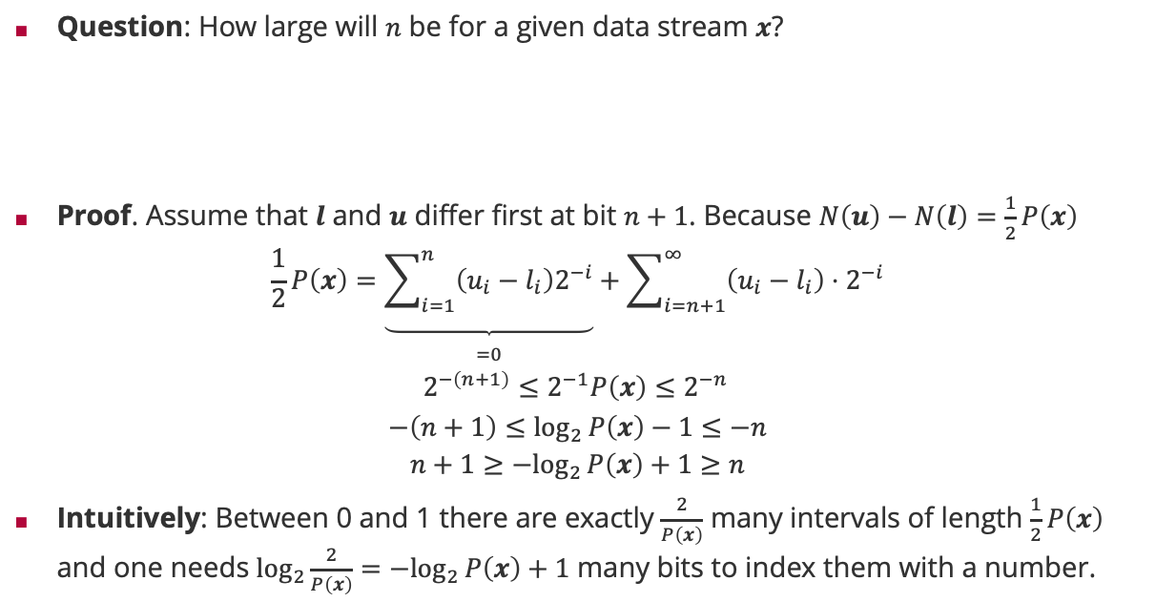
Arithmetic Coding: Optimal Code Length
Question: How large will $n$ be for a given data stream $x$?
Proof. Assume that $l$ and $u$ differ first at bit $n+1$. Because $N\left(u\right)−N\left(l\right)=\frac{1}{2}P\left(x\right)$
$$\frac{1}{2}P\left(x\right)=\underset{\begin{aligned} \\ =0\end{aligned}}{\underbrace{\sum_{i=1}^{n}{\left(u_{i}−l_{i}\right)2^{−i}}}}+\sum_{i=n+1}^{∞}{\left(u_{i}−l_{i}\right)⋅2^{−i}}$$
$$2^{−\left(n+1\right)}≤2^{−1}P\left(x\right)≤2^{−n }$$
$$−\left(n+1\right)≤\log_{2}{P\left(x\right)−1}≤−n$$
$$n+1≥{−log}_{2}{P\left(x\right)}+1≥n$$
Intuitively: Between 0 and 1 there are exactly $\frac{2}{P\left(x\right)}$ many intervals of length $\frac{1}{2}P\left(x\right)$ and one needs $\log_{2}\frac{2}{P\left(x\right)}={−log}_{2}{P\left(x\right)}+1$ many bits to index them with a number.
$$−\log_{2}{P\left(x\right)}≤n≤−\log_{2}{P\left(x\right)}+1$$

Slide 18
Overview
Basics of Information Theory
Probability and Compression: Arithmetic Coding
Distance Measures for Probabilities Revisited

Slide 19
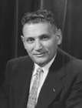
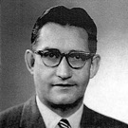
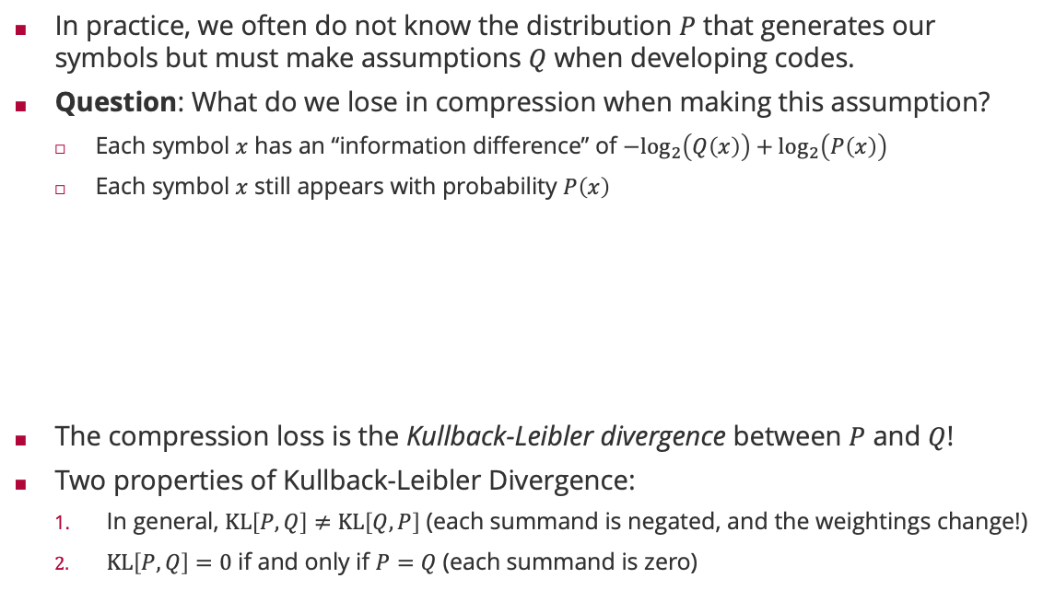
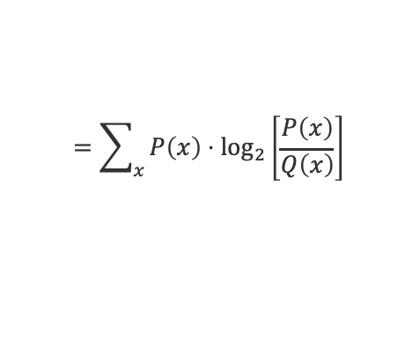
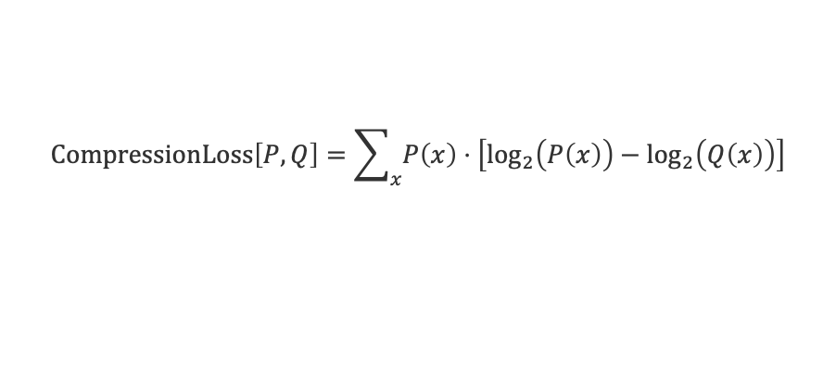
Coding with Imperfect Information
In practice, we often do not know the distribution $P$ that generates our symbols but must make assumptions $Q$ when developing codes.
Question: What do we lose in compression when making this assumption?
Each symbol $x$ has an “information difference” of ${−log}_{2}\left(Q\left(x\right)\right)+\log_{2}\left(P\left(x\right)\right)$
Each symbol $x$ still appears with probability $P\left(x\right)$
The compression loss is the Kullback-Leibler divergence between $P$ and $Q$!
Two properties of Kullback-Leibler Divergence:
In general, $KL\left[P,Q\right]≠KL\left[Q,P\right]$ (each summand is negated, and the weightings change!)
$KL\left[P,Q\right]=0$ if and only if $P=Q$ (each summand is zero)
Solomon Kullback (1909 – 1994)
$$CompressionLoss\left[P,Q\right]=\sum_{x}{P\left(x\right)⋅\left[\log_{2}\left(P\left(x\right)\right)−\log_{2}\left(Q\left(x\right)\right)\right]}$$
$$=\sum_{x}{P\left(x\right)⋅\log_{2}\left[\frac{P\left(x\right)}{Q\left(x\right)}\right]}$$
Richard Leibler (1914 – 2003)

Slide 20
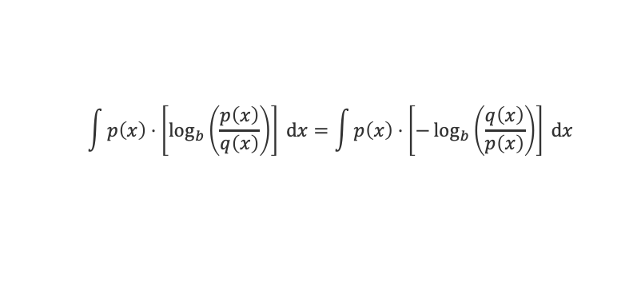

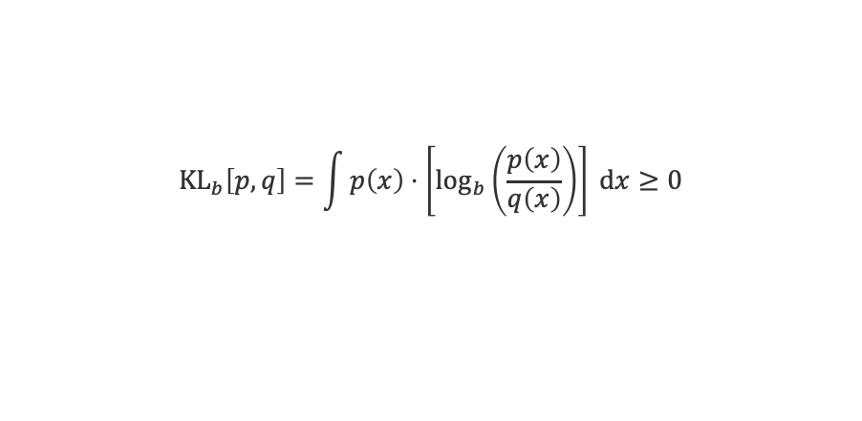




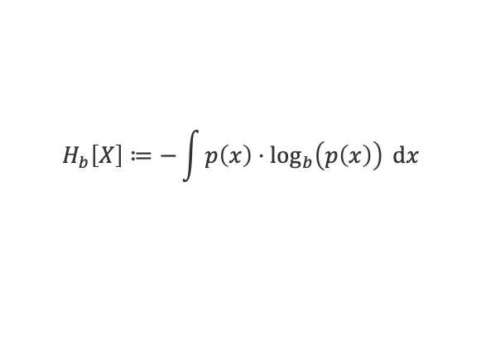
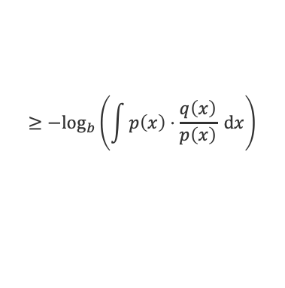
(Relative) Entropy of Continuous Random Variables
Question: What is entropy of a continuous random variable?
Differential Entropy. The differential entropy of a continuous random variable $X$ is the average level of information inherent to the variable’s outcomes
Differential entropy can be negative and has no interpretation!
Relative Entropy. The KL divergence between two densities does have an interpretation in terms of bits (base 2) or nats (base $e$) because
Proof: Using Jensen’s inequality for the convex function $−\log_{b}\left(t\right)$ we see that
$$H_{b}\left[X\right]≔−\int{p\left(x\right)⋅\log_{b}\left(p\left(x\right)\right) dx}$$
$$=E_{X∼P}\left[−\log_{b}\left(p\left(X\right)\right)\right]$$
$$X∼𝒩\left(x;μ,σ^{2}\right)$$
$$H_{e}\left[X\right]=\frac{1}{2}\left[\log\left(2πσ^{2}\right)+1\right]$$
$${KL}_{b}\left[p,q\right]=\int{p\left(x\right)⋅\left[\log_{b}\left(\frac{p\left(x\right)}{q\left(x\right)}\right)\right] dx}≥0$$
$$\int{p\left(x\right)⋅\left[\log_{b}\left(\frac{p\left(x\right)}{q\left(x\right)}\right)\right] dx}=\int{p\left(x\right)⋅\left[−\log_{b}\left(\frac{q\left(x\right)}{p\left(x\right)}\right)\right] dx}$$
$$≥−\log_{b}\left(\int{p\left(x\right)⋅\frac{q\left(x\right)}{p\left(x\right)} dx}\right)$$
$$=0$$

Slide 21
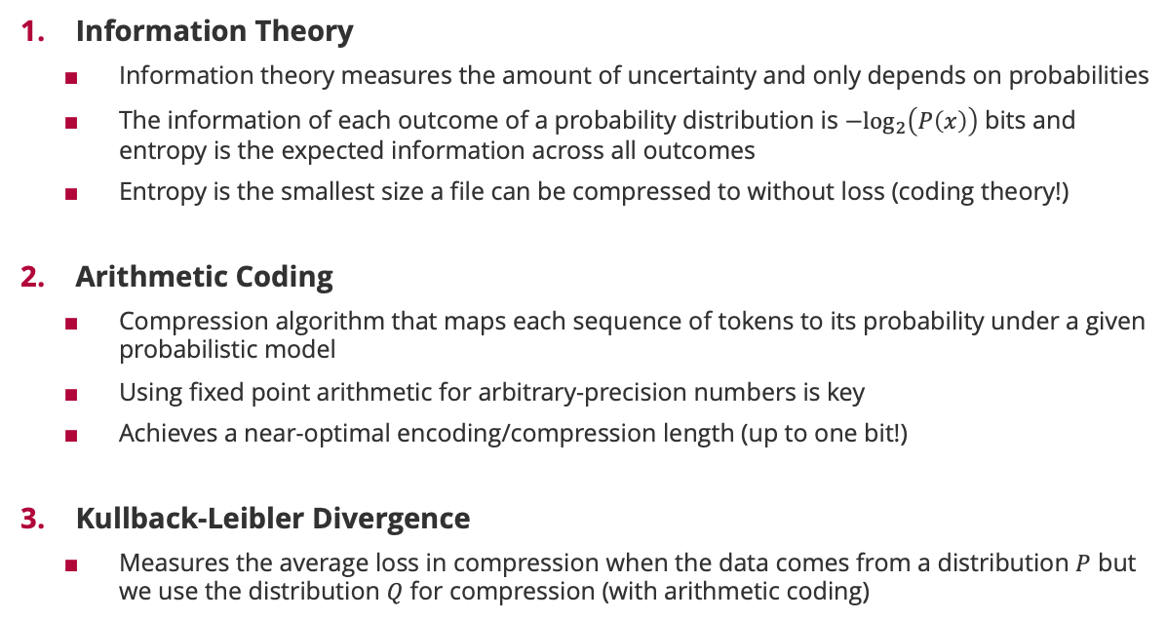
Summary
Information Theory
Information theory measures the amount of uncertainty and only depends on probabilities
The information of each outcome of a probability distribution is $−\log_{2}\left(P\left(x\right)\right)$ bits and entropy is the expected information across all outcomes
Entropy is the smallest size a file can be compressed to without loss (coding theory!)
Arithmetic Coding
Compression algorithm that maps each sequence of tokens to its probability under a given probabilistic model
Using fixed point arithmetic for arbitrary-precision numbers is key
Achieves a near-optimal encoding/compression length (up to one bit!)
Kullback-Leibler Divergence
Measures the average loss in compression when the data comes from a distribution $P$ but we use the distribution $Q$ for compression (with arithmetic coding)

Slide 22
See you next week!

